Slide 1
Deep Learning in Computer Vision (Part-5)
Generative Models
Computer Vision, 6th Semester, 2024

Slide 2
Autoencoders
Autoencoder: a type of deep network used primarily for unsupervised learning tasks
Main purpose:
Learn efficient representations or encodings of data
Used for dimensionality reduction, feature extraction, and data generation
The two main parts of an autoencoder:
Encoder
Takes in the input data and encodes it into a compact representation (“latent space” / “encoding” / “embedding”)
Decoder
Takes the encoded representation from the encoder and tries to reconstruct the original input data
Goal:
Minimize the difference between the input data and the reconstructed data
Learning to reconstruct the input data through the compact representation.

Slide 3
Architecture and Training of Autoencoders
Architecture
Training Process
Input Layer
Hidden Layers (Encoder):
Transform input data into a compressed representation.
Latent Space:
Contains the compressed representation (encoding) of the input data.
Hidden Layers (Decoder):
Try to reconstruct original data from encoding.
Output Layer
Forward Pass:
The input data is passed through the encoder to obtain the encoded representation (used to reconstruct).
Loss Calculation:
A loss function measures the difference between the input data and the reconstructed data.
Backward Pass (Backpropagation):
The loss is backpropagated through the network to update the weights and minimize the loss, thereby improving the reconstruction quality.

Slide 4
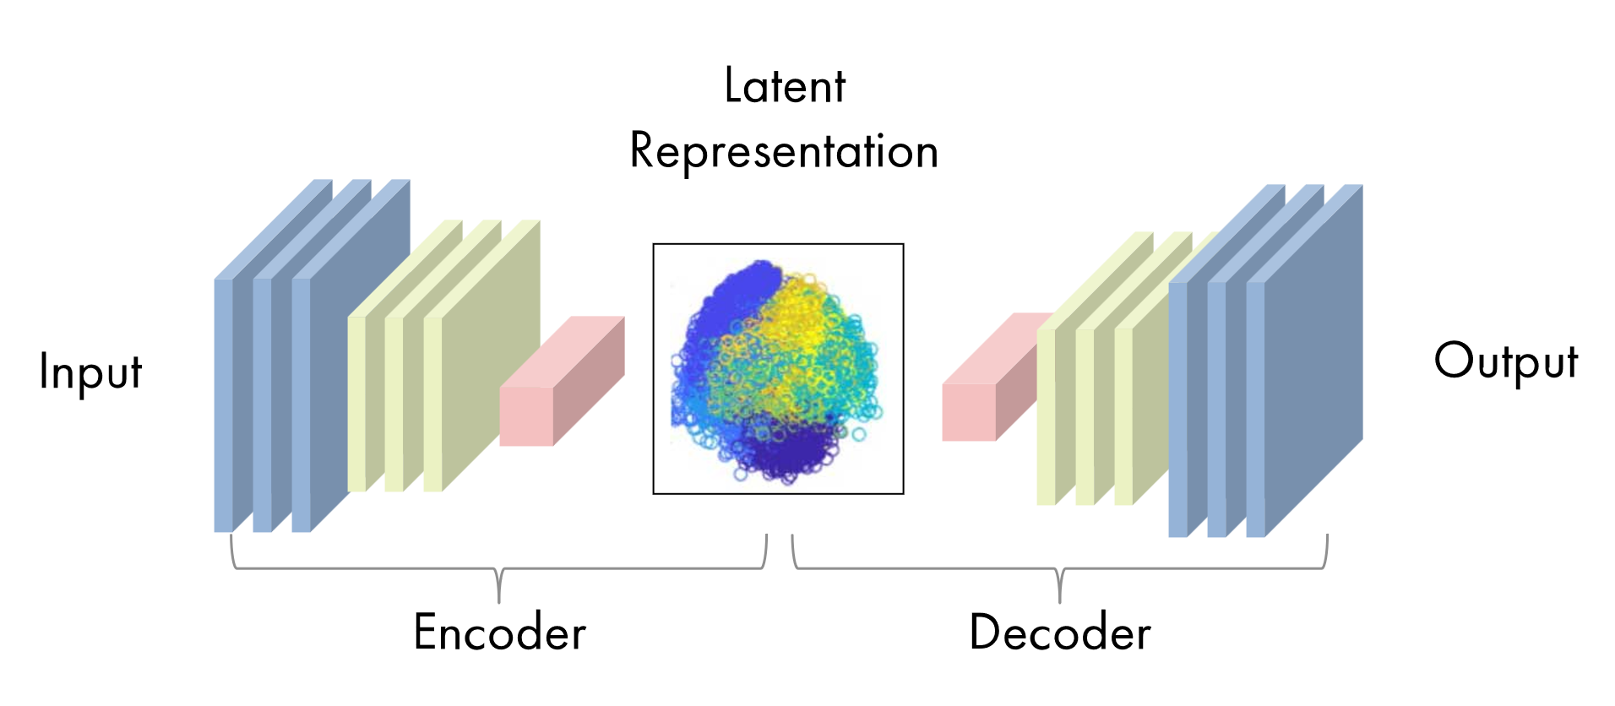
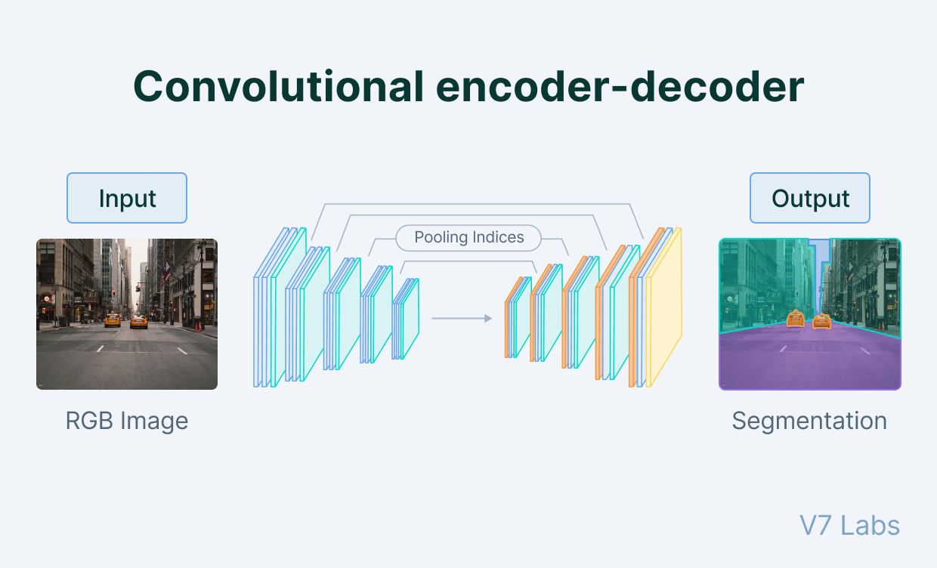
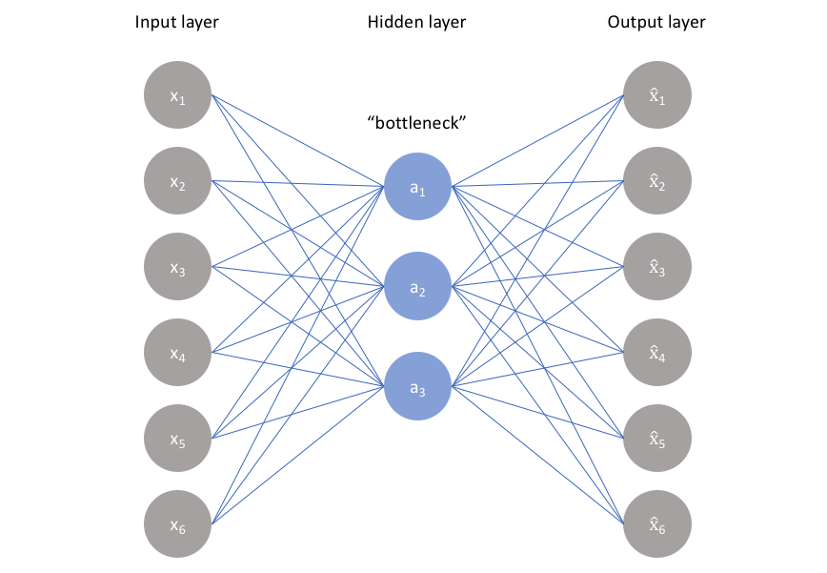
Autoencoder

Slide 5
Hyper-parameters for training an autoencoder
Code size:
The bottleneck size decides the extent to which the data has to be compressed.
This can also act as a regularization term.
Number of layers:
While a higher depth increases model complexity, a lower depth is faster to process.
Number of nodes per layer:
The number of nodes per layer defines the weights we use per layer.
Encoder – no. of nodes decreases down the pipeline; decoder – no. of nodes increases down the pipeline.
Reconstruction Loss:
The loss function we use to train the autoencoder is highly dependent on the type of input and output we want the autoencoder to adapt to.
Examples: Mean Square Error (MSE), L1 loss, K-L Divergence, Binary Cross Entropy

Slide 6
Applications of Autoencoders
Dimensionality Reduction:
Reducing the number of features (dimensions) in data while preserving important information.
Feature Extraction:
Learning meaningful features or representations from raw data.
Anomaly Detection:
Identifying unusual patterns or outliers in data.
Data Denoising (Denoising Autoencoder):
Removing noise from data by learning to reconstruct the clean data.

Slide 7
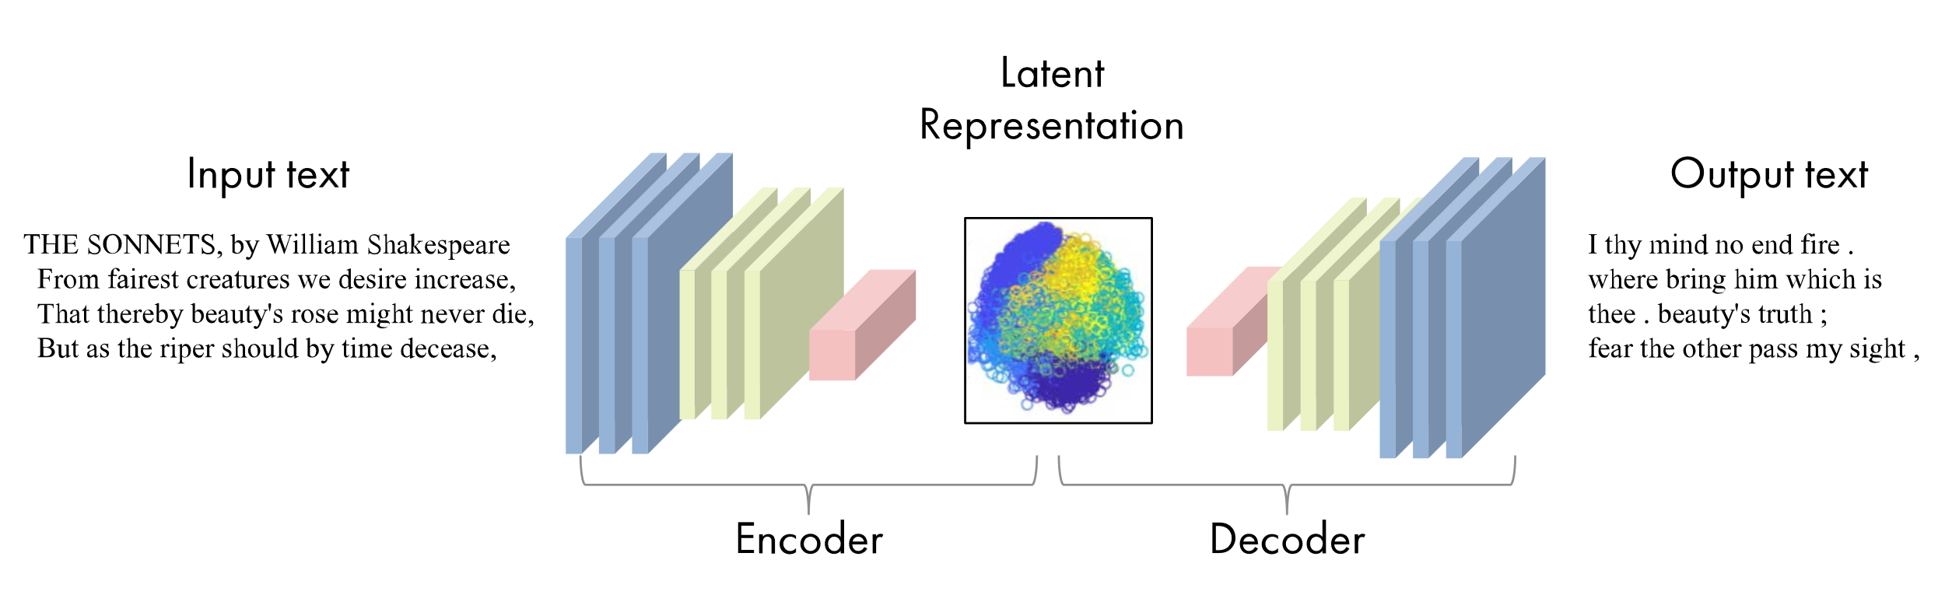
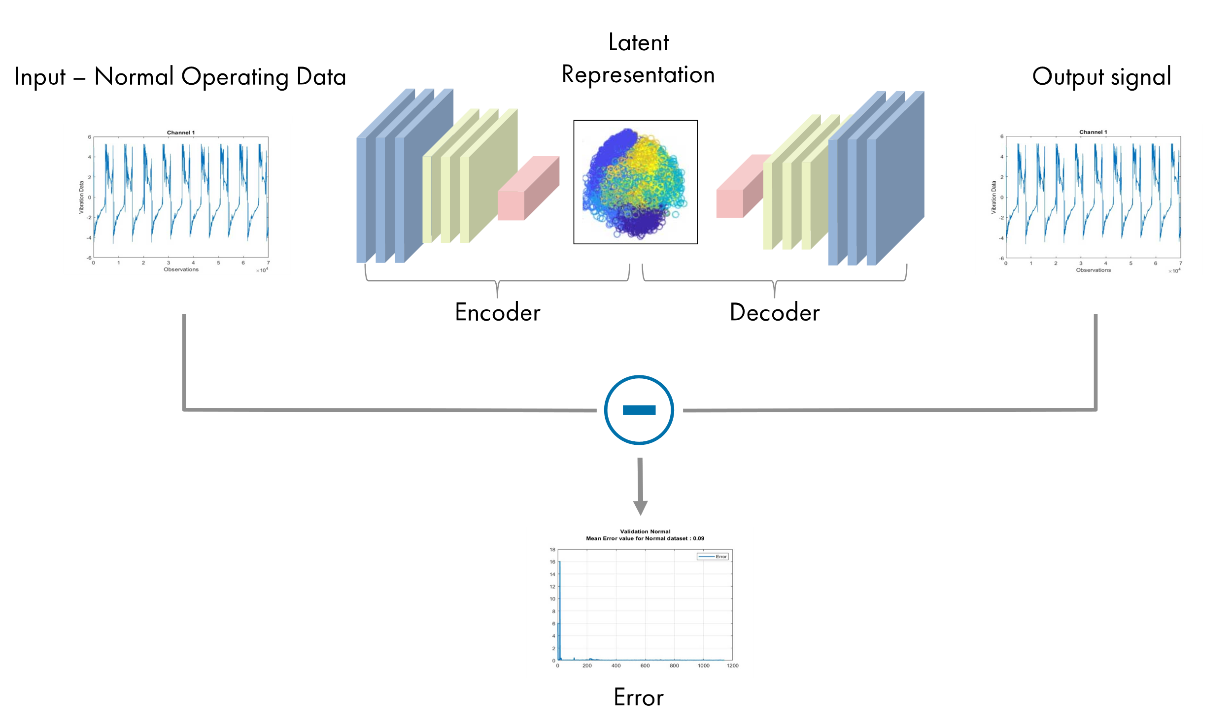
Applications of Autoencoders
Text Generation
System Maintenance Check

Slide 8
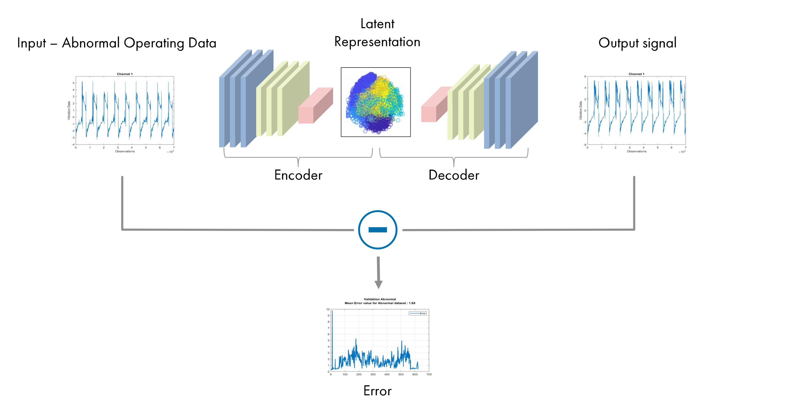
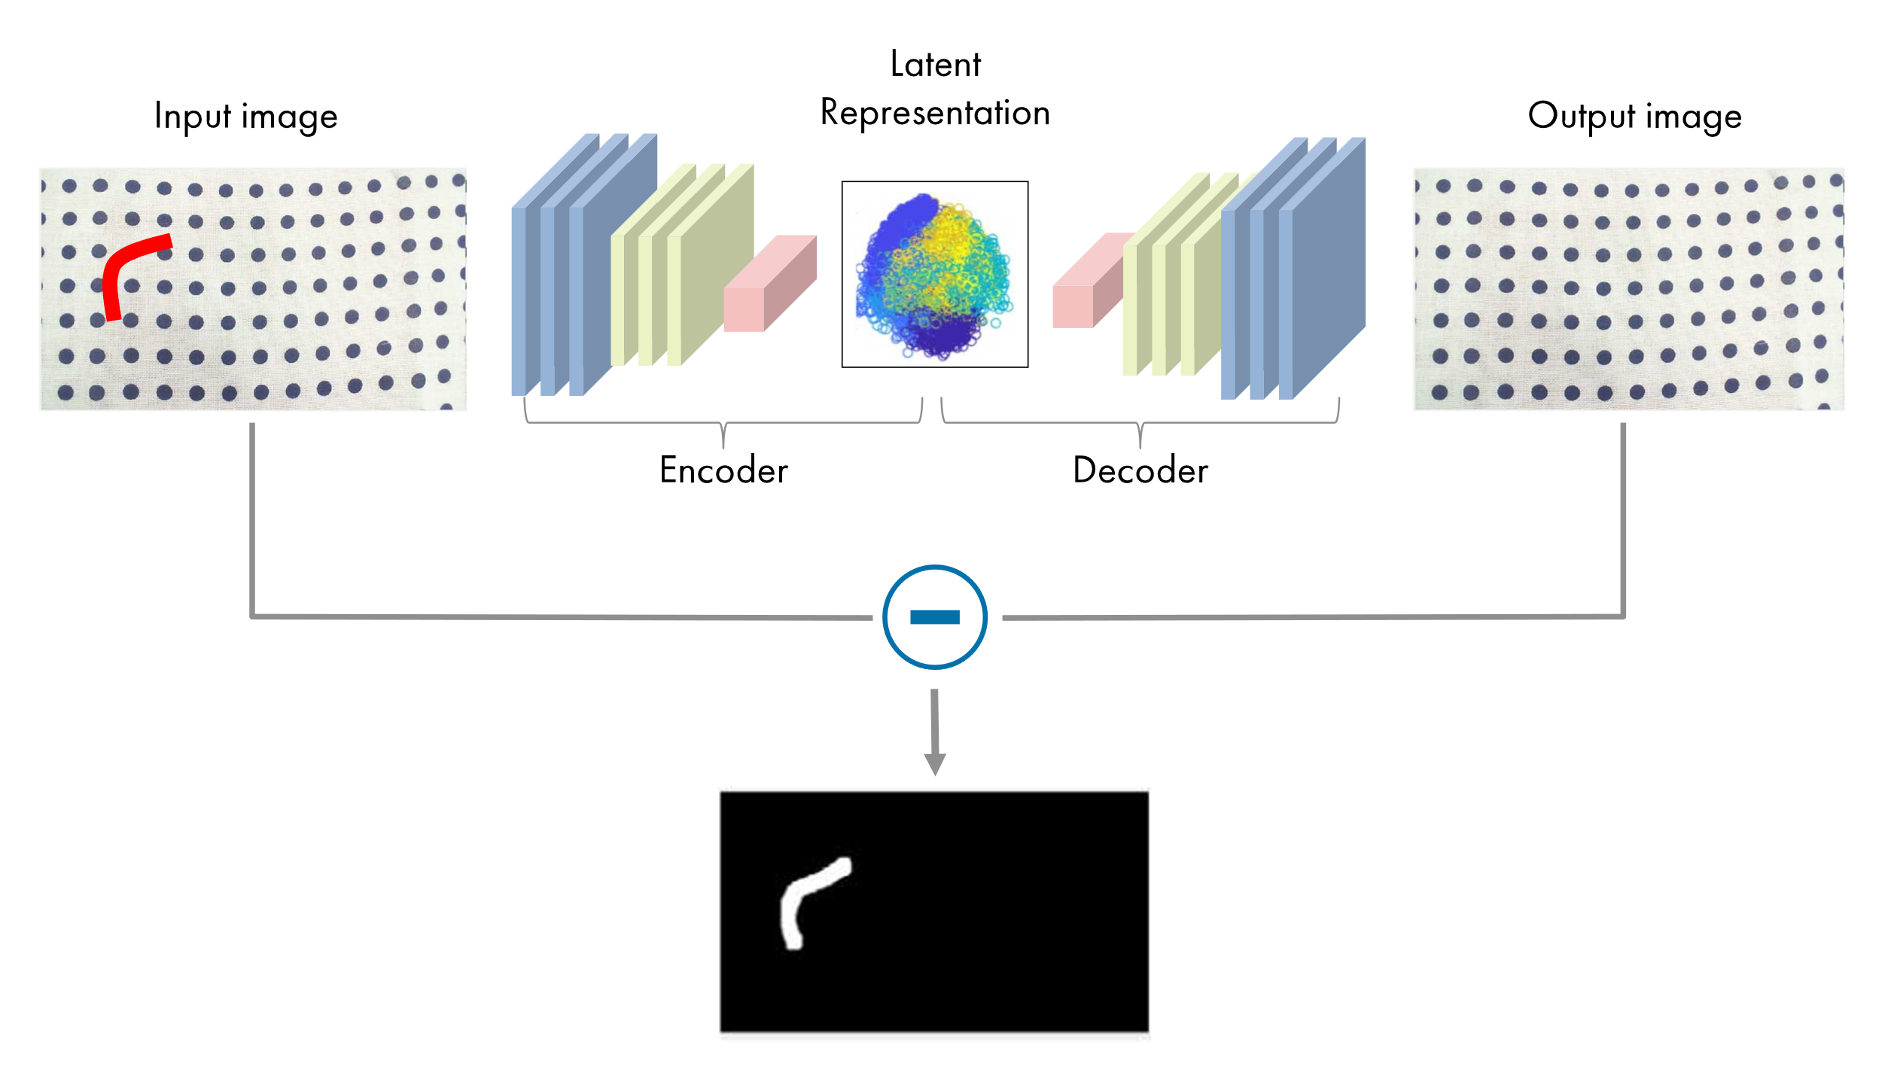
Applications of Autoencoders
Error/Anomaly Detection in Operating Data
Error/Anomaly Detection in Images

Slide 9
Autoencoder variants
Over-complete autoencoders:
Hidden layer (latent space) is larger than the input and output layers
Learning of more complex and detailed representations of the input data
Under-complete autoencoders:
Latent space has fewer dimensions than the input and output layers
Efficient dimensionality reduction and feature extraction
Contractive autoencoders:
Designed to learn a compact and stable representation of the input data
Incorporates a contractive regularization term into the loss function during training
Penalizing large gradients in the latent space
Learning of robust and invariant features
Denoising Autoencoders:
Trained to reconstruct clean data from noisy data.
Sparse Autoencoders:
Encourage the learning of sparse representations where only a subset of neurons are activated.
Variational Autoencoders (VAEs):
Learn probabilistic latent representations and are capable of generating new data samples.
Adversarial Autoencoders (AAEs):
Combine autoencoders with adversarial training to learn more diverse latent representations.

Slide 10
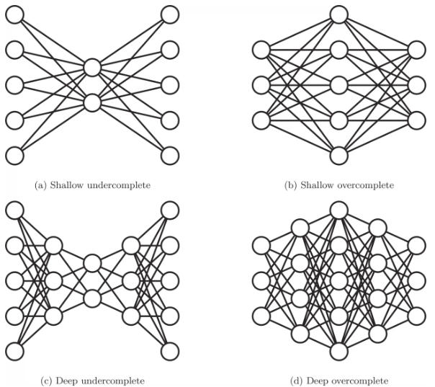
Under-complete and over-complete autoencoders
Length/depth:
Shallow: few layers (in-hidden-out)
Deep: many layers (in-h1-h2…hk-out)
Width:
Under-complete: less hidden neurons
Over-complete: more hidden neurons
Less or more: than input/output layer

Slide 11
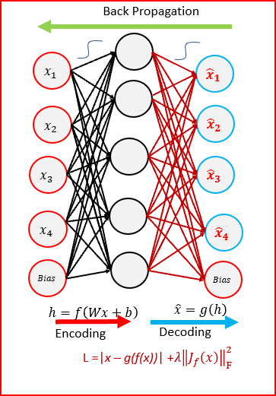
Contractive autoencoder
Penalty function added to loss function

Slide 12
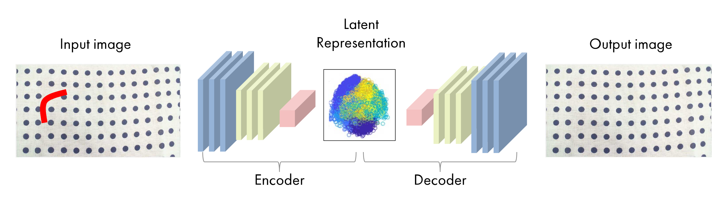
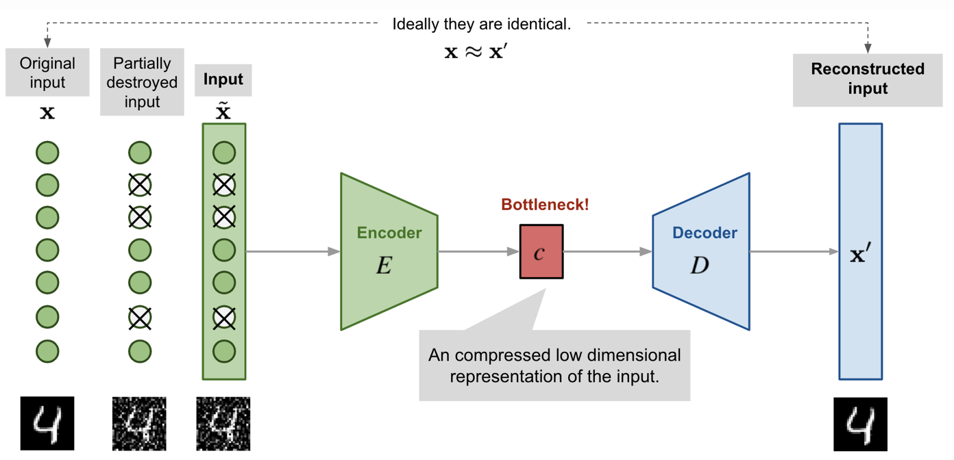
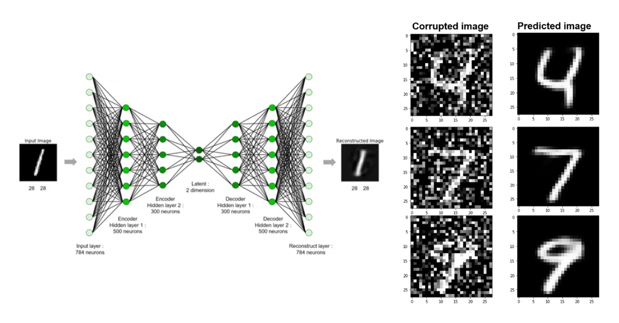
Denoising autoencoder (DNAE)

Slide 13
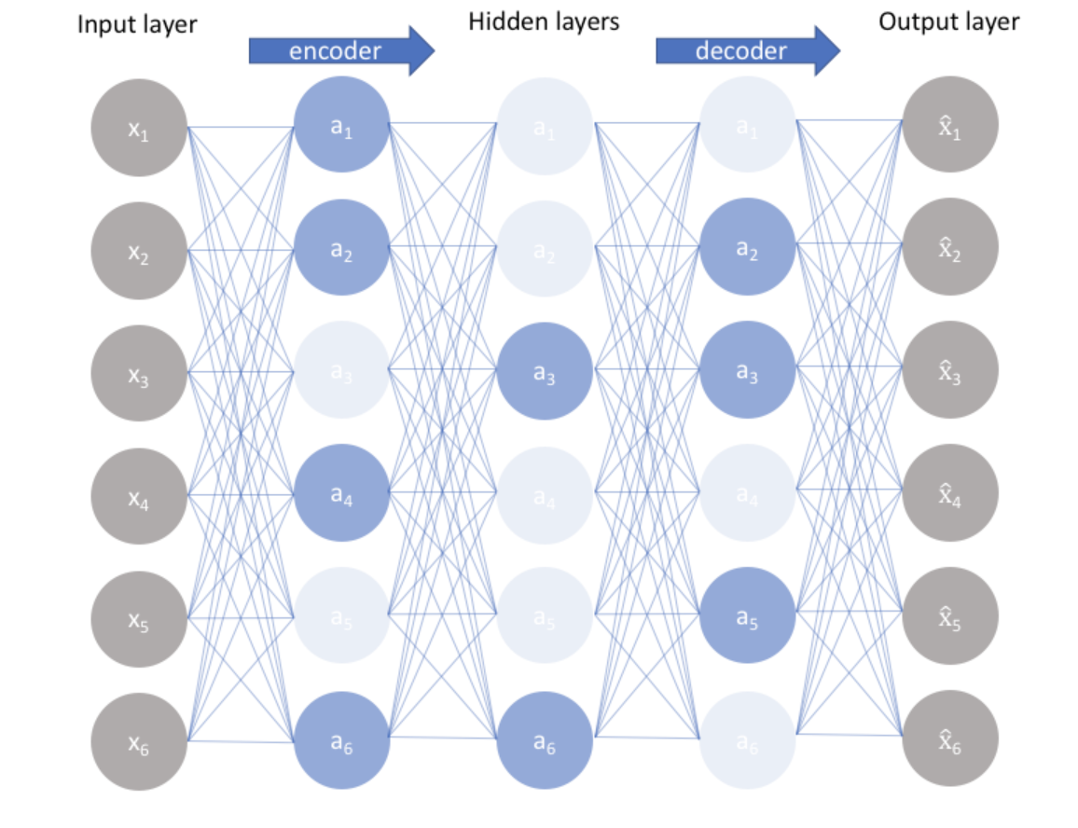
Sparse autoencoder (SAE)

Slide 14
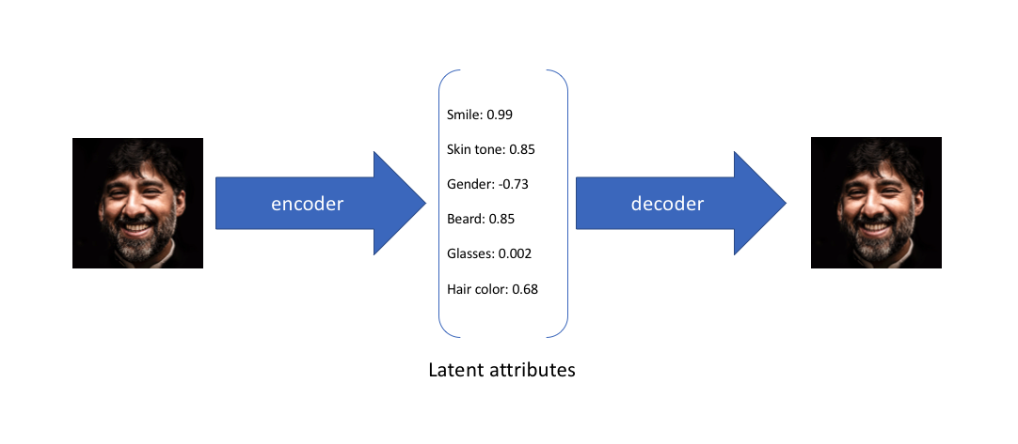
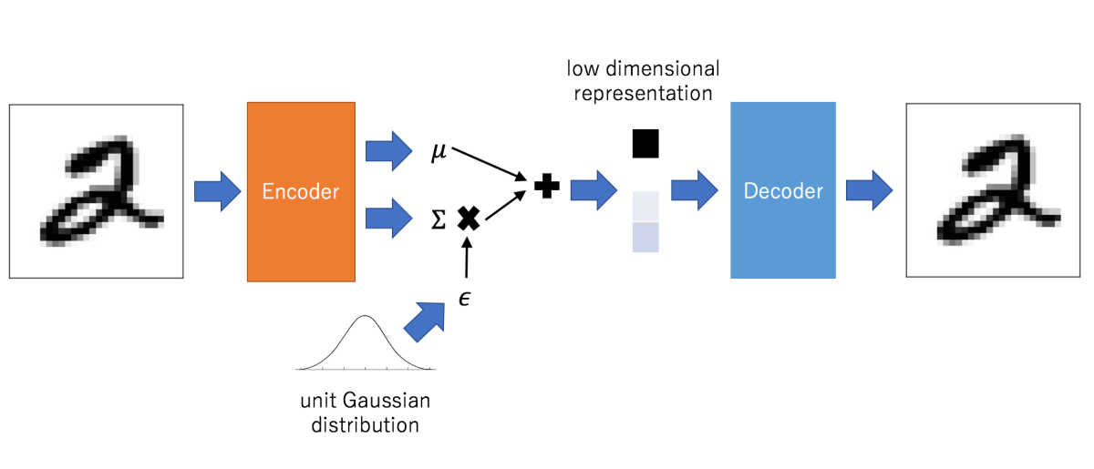
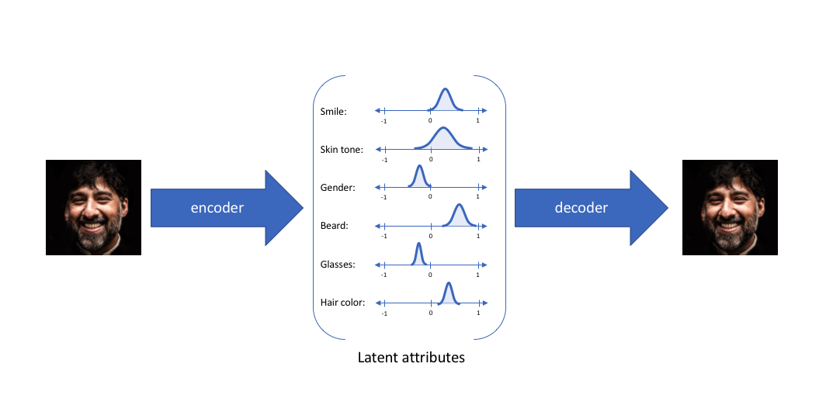
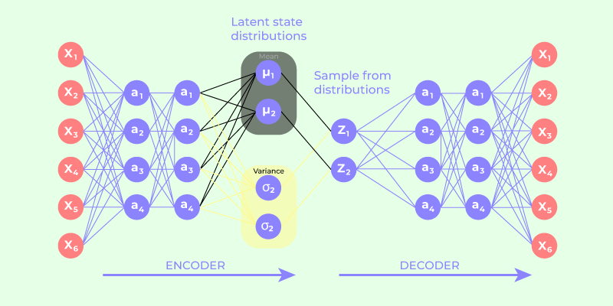
Variational autoencoder (VAE)
Traditional to Variational

Slide 15
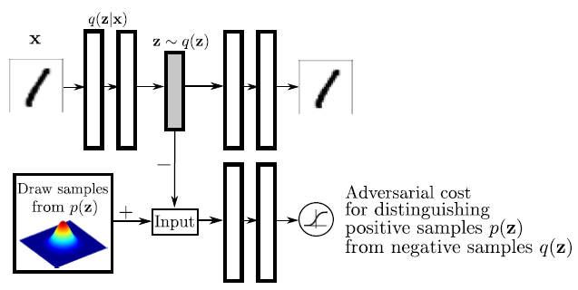
Adversarial autoencoder

Slide 16
Generative Adversarial Networks (G.A.N.)
Generative Adversarial Networks (GANs):
used for generating new data samples that are similar to a given set of real data.
GANs consist of two neural networks trained simultaneously and competitively/adversarially.
Generator:
generates synthetic data samples from a given distribution
Discriminator:
evaluates the authenticity of these samples by distinguishing between real and generated data.
GANs can produce high-quality and realistic data samples across various domains of media.

Slide 17
Architecture of G.A.N. – Two Neural Networks
Generator
Discriminator
The generator takes random noise as input and generates data samples, attempting to produce synthetic data that is indistinguishable from real data.
Architecture of Generator:
Input Layer:
Accepts a random noise vector or latent space vector as input.
Hidden Layers:
Multiple layers (usually fully connected or convolutional layers) that transform the input noise into a HIGHER-dimensional representation.
Output Layer:
Produces the generated data sample that should resemble real data.
The discriminator evaluates the authenticity of the generated data samples by distinguishing between real and fake (generated) data.
Architecture of Discriminator:
Input Layer:
Accepts a data sample (either real or generated) as input.
Hidden Layers:
Multiple layers (usually fully connected or convolutional layers) that transform the input data into a LOWER-dimensional representation.
Output Layer:
Produces a binary classification output indicating whether the input data is real or fake.

Slide 18
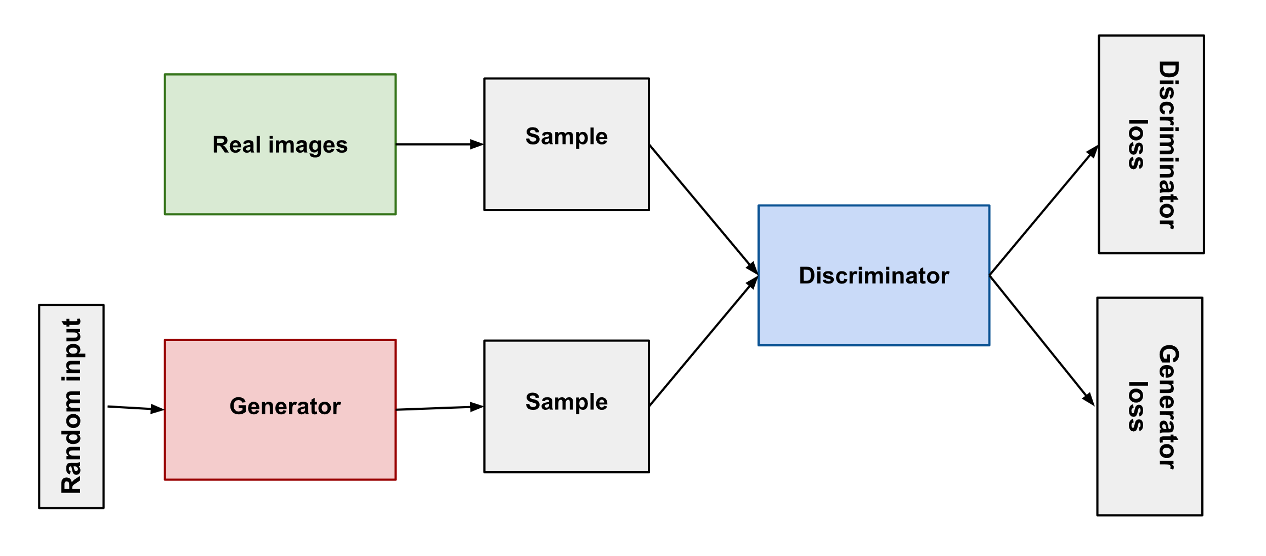
Basic Architecture of A G.A.N.

Slide 19
G.A.N. Training
Initialize the Generator and Discriminator:
Initialize the weights and biases of the generator and discriminator neural networks with random or pre-trained values.
Generate Fake Data:
Input random noise into the generator to produce fake data samples.
Combine with Real Data:
Combine the generated fake data with real data samples.
Feed into Discriminator:
Pass the combined real and fake data through the discriminator.
Compute Discriminator Loss:
Calculate the discriminator's loss ‘Ld’ based on its ability to correctly classify the real and fake data.
Compute Generator Loss:
Calculate the generator's loss ‘Lg’ based on the discriminator's ability to correctly classify the fake data as generated.
Backpropagation:
Backpropagate Lg through the generator and Ld through the discriminator.
Update Generator and Discriminator Weights:
After computing the losses and backpropagating through the networks, update the weights and biases of both the generator and discriminator.
Iterate:
Repeat the adversarial training process until convergence criteria are met.
Evaluate the Quality of Generated Samples:
Periodically evaluate the quality and realism of the generated samples using metrics and visual inspection.
Check Convergence:
Monitor the convergence of the training process by observing the generator and discriminator losses over time.
Stop Training:
Stop the training process when the generator produces high-quality and realistic data samples or when the discriminator's accuracy plateaus.
Deploy the Trained GAN:
Use the trained generator to generate new data samples for various applications like image synthesis, data augmentation, style transfer, etc.

Slide 20
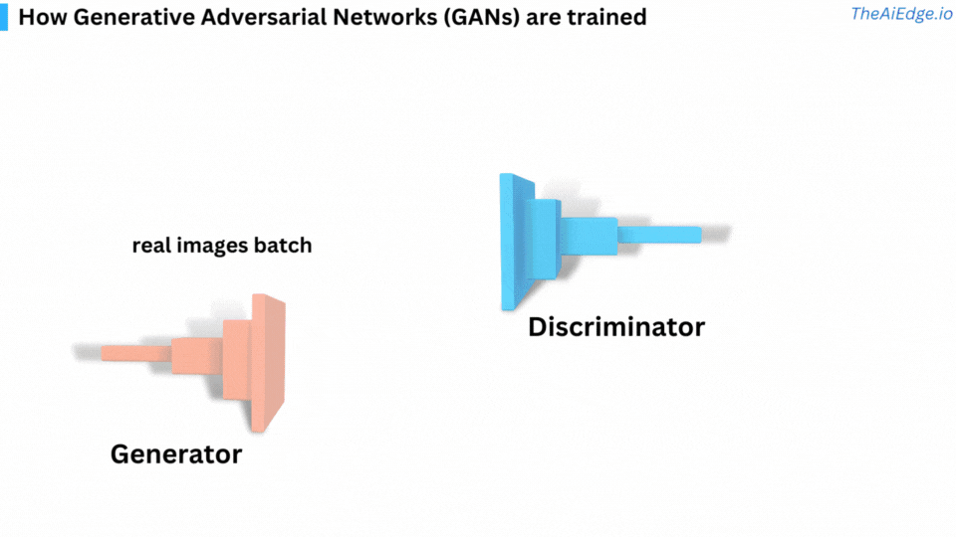
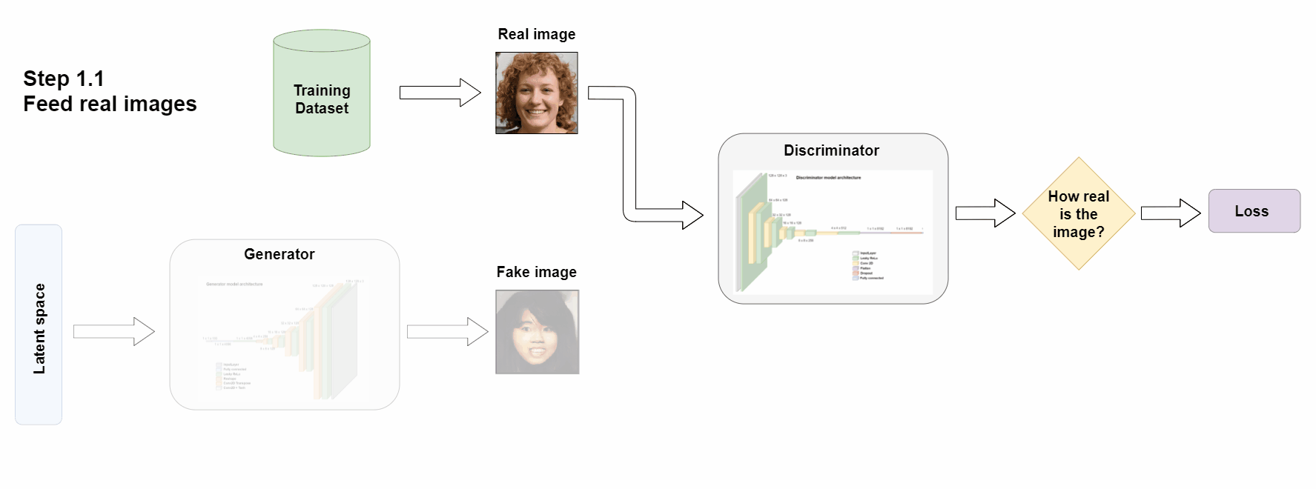
G.A.N. Training

Slide 21
Loss Functions in G.A.N. training
Generator Loss:
Measures the generator's ability to produce realistic data samples that fool the discriminator.
Discriminator Loss:
Measures the discriminator's ability to distinguish between real and fake data samples.
Common loss functions used in GANs:
minimax loss
Wasserstein loss
Refer: https://developers.google.com/machine-learning/gan/loss

Slide 22
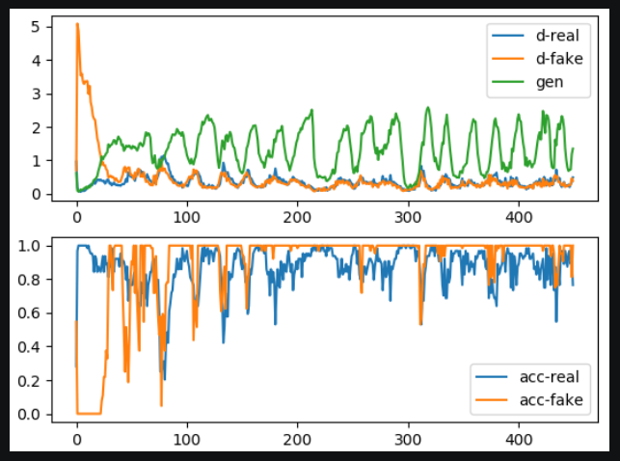
G.A.N. – Accuracy and Loss trends

Slide 23
Applications of G.A.N.
Image Synthesis and Generation
Data Augmentation
Style Transfer and Image-to-Image Translation
Super-Resolution
Anomaly Detection and Data Denoising
Text-to-Image Synthesis
Drug Discovery and Molecular Design
StyleGAN and Face Generation
Video Synthesis and Generation
Domain Adaptation and Transfer Learning

Slide 24
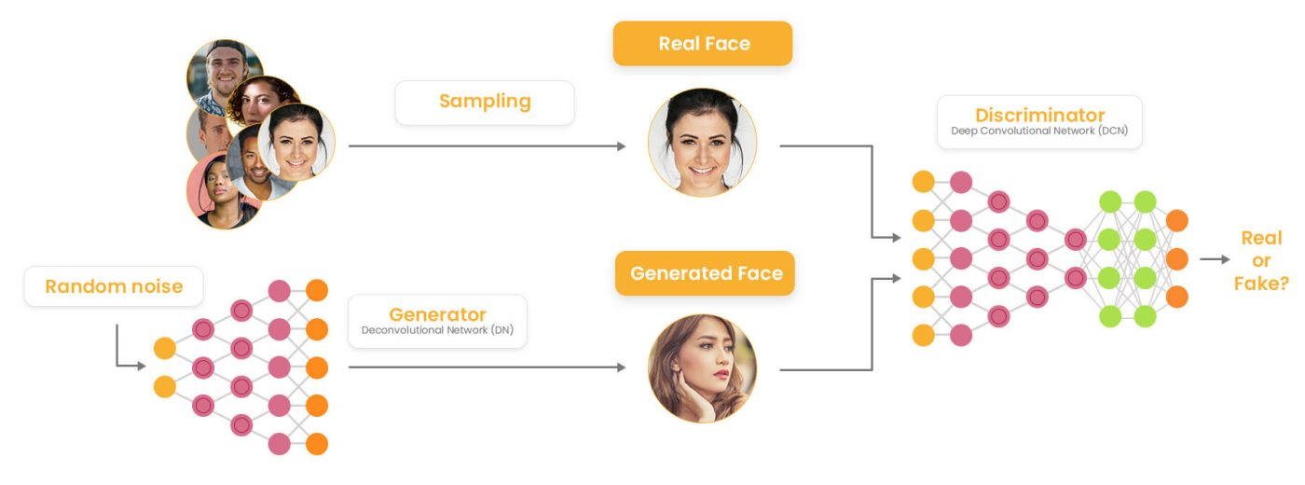
G.A.N. – Deepfake (Fake Face Generation)

Slide 25
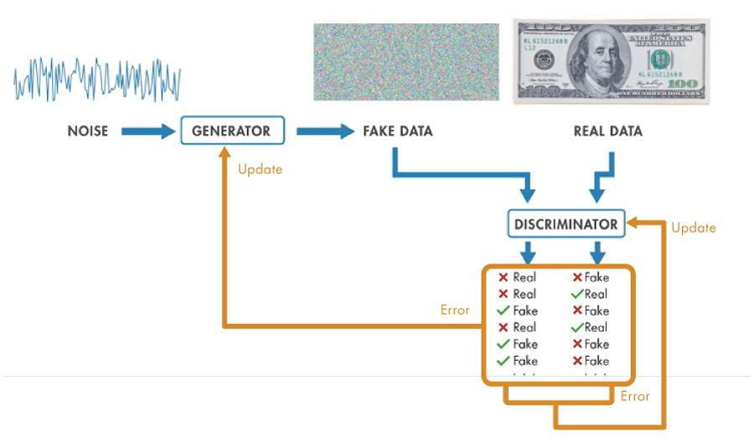
G.A.N. – Fake Currency Detection

Slide 26
G.A.N. Variants
Vanilla GAN
Conditional GAN
Dual GAN
Stack GAN
Cycle GAN
Style GAN
Deep Convolutional GAN
Wasserstein GAN
Energy-based GAN
Super-Resolution GAN
Mode-Regularized GAN
Disco-GAN
LS-GAN
PG-GAN (Progressively Growing GAN)

Slide 27
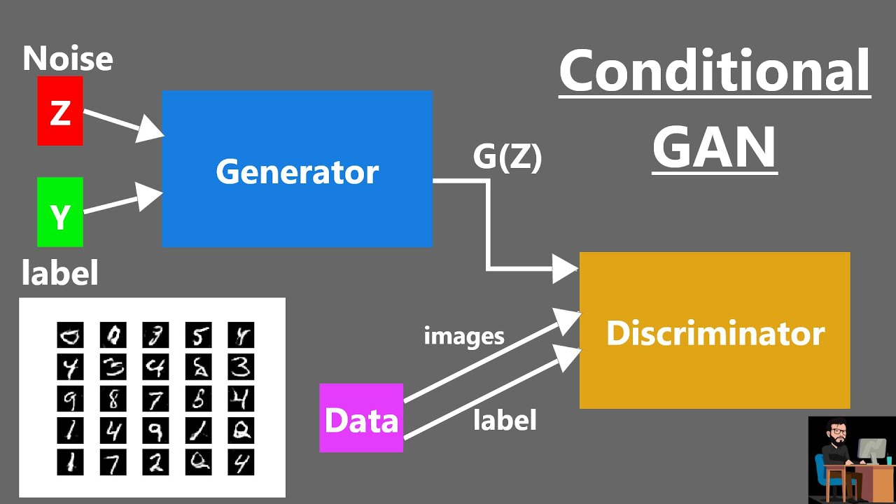
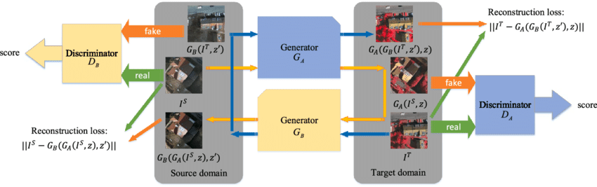
G.A.N. Variants
Conditional GAN
Dual GAN

Slide 28
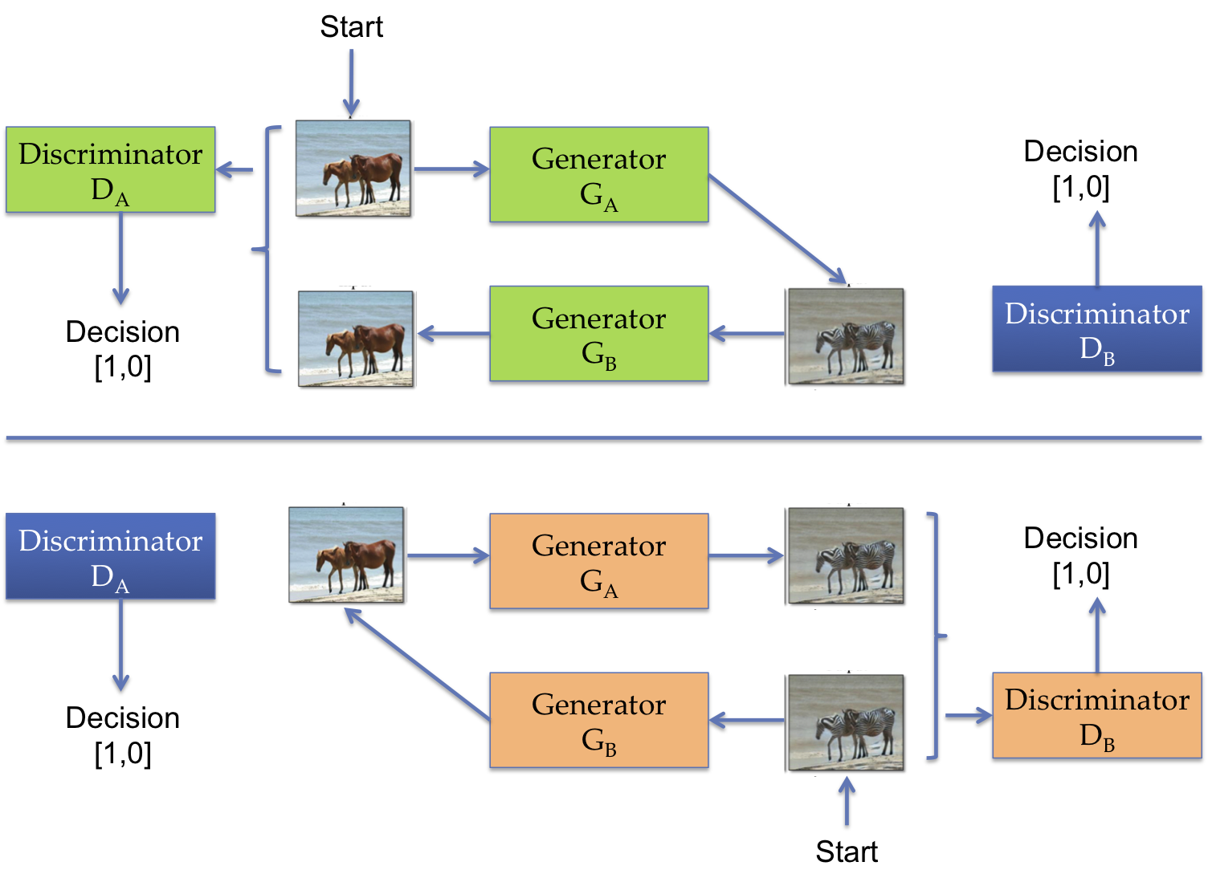
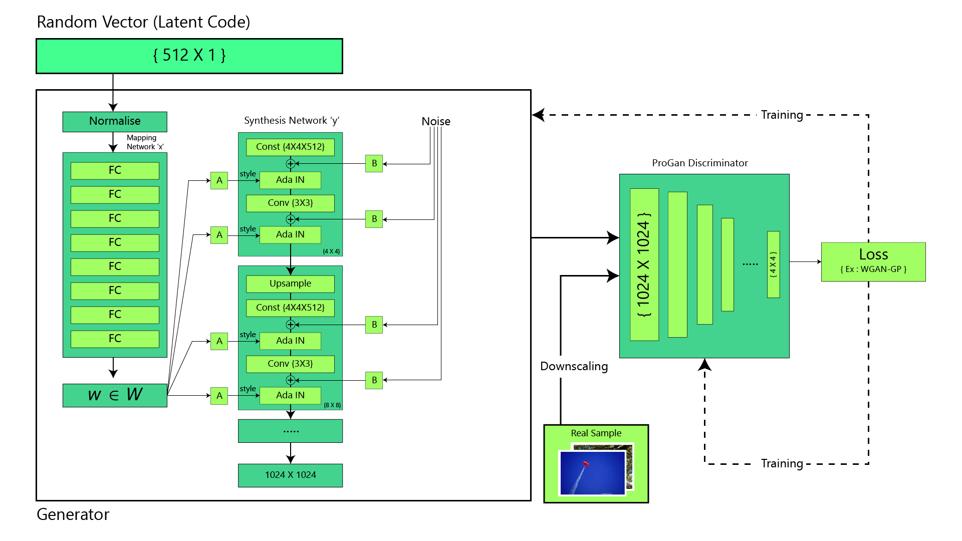
G.A.N. Variants
Cycle GAN
Style GAN

Slide 29
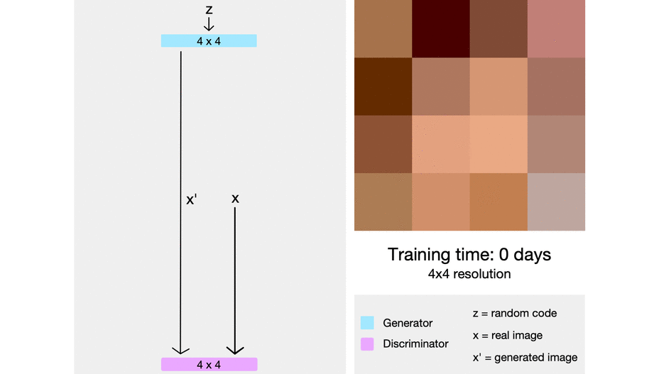
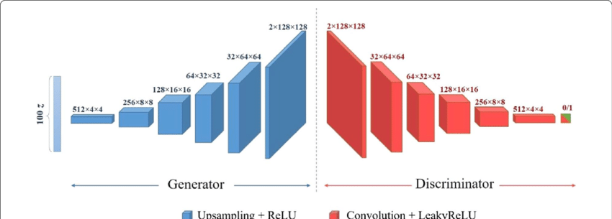
G.A.N. Variants
Deep Convolutional GAN
(DC-GAN)
Progressively Growing GAN
(PG-GAN)

Slide 30
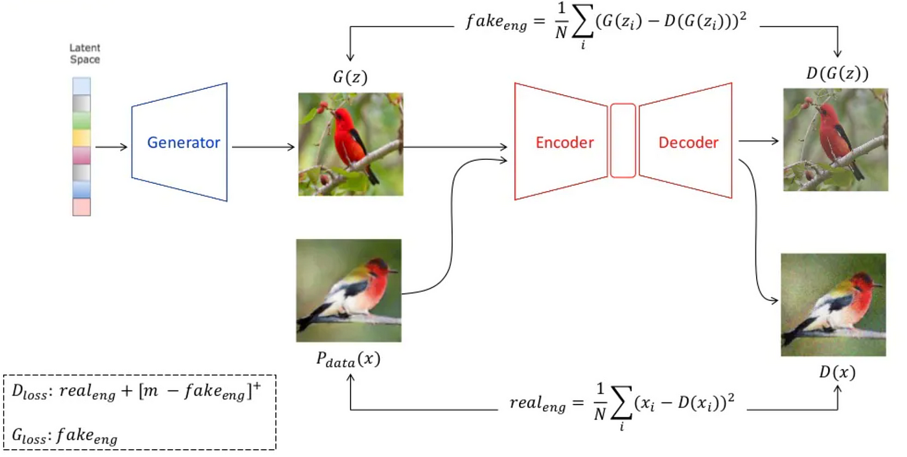
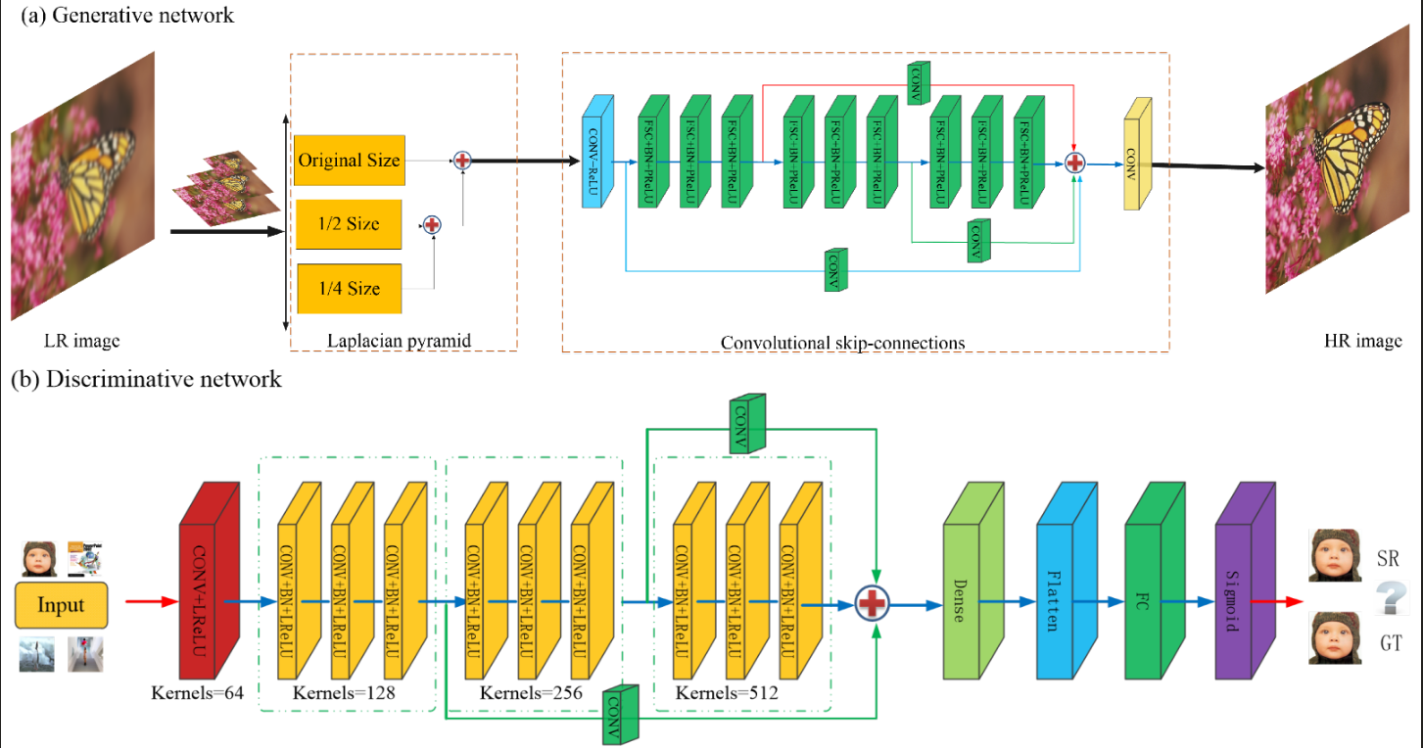
G.A.N. Variants
Energy-Based GAN
Super-Resolution GAN

Slide 31
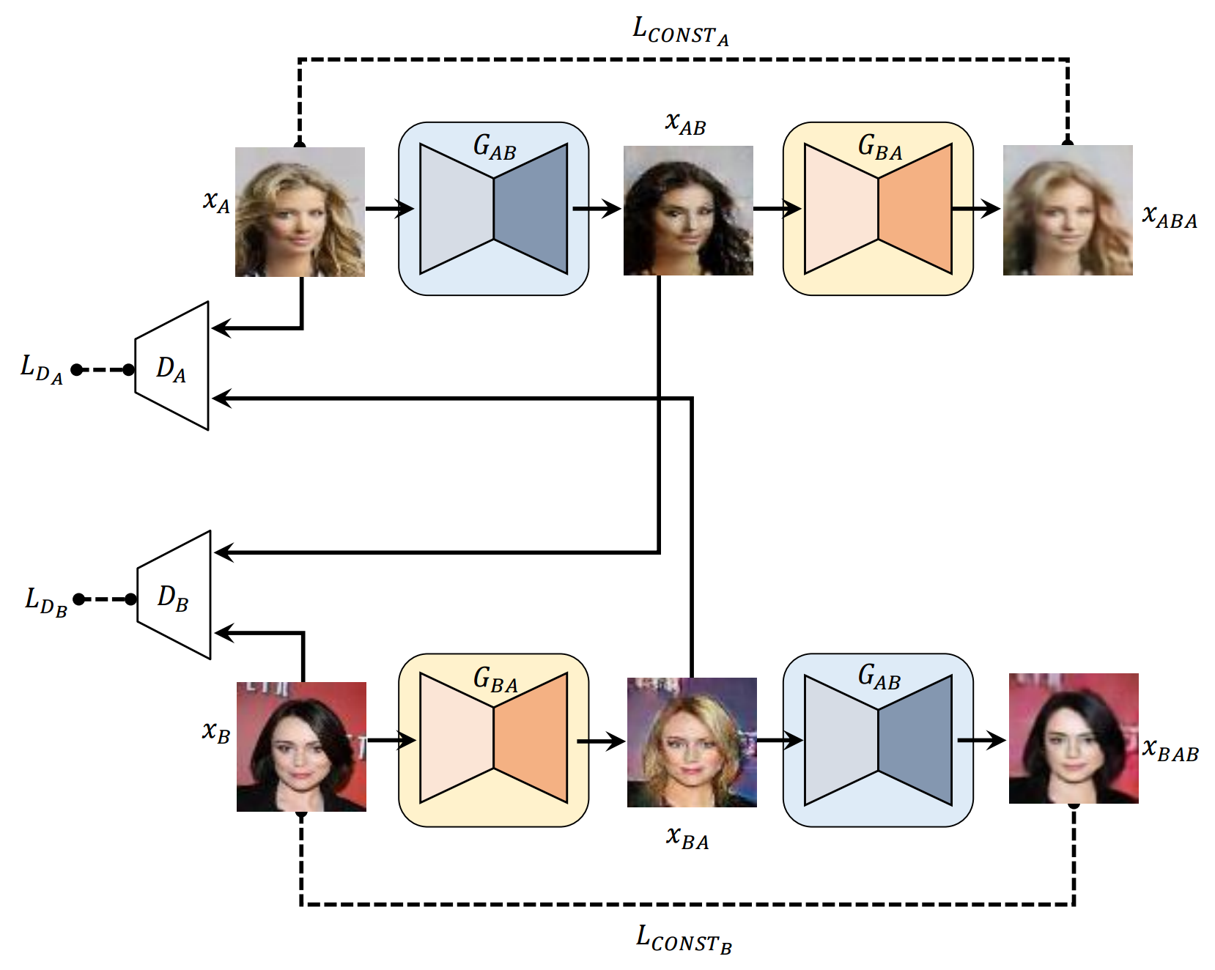
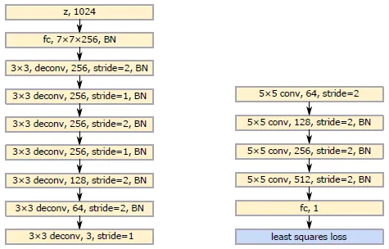
G.A.N. Variants
Disco-GAN
LS-GAN

